Slide 1
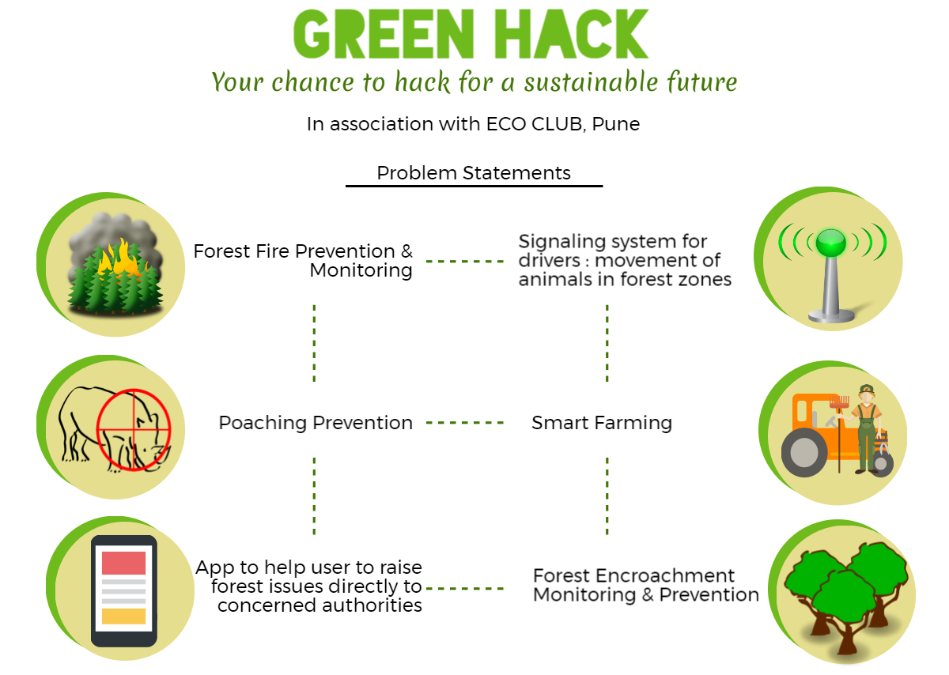

Slide 2
Team Name – ECOTUNE
Content
Problem Context : Smart Farming
The Solution
Architecture and Demo

Slide 3
Problem Context : Smart Farming
Problem Statement
Within 24 Hours of hackathon, build a working solution which can help in reducing the damage due to uncertain weather forecast, unorganized farming, and return on investments for farmers for their efforts and money.
Who are our customers:
Farmers
Government and non government Organizations
Merchants and brokers

Slide 4
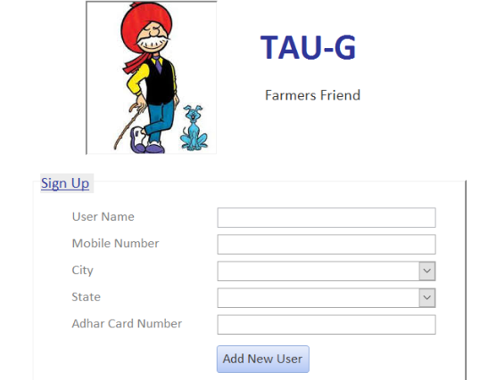
The Solution
Desktop application
Tools used
MS-Access
VBA
Why Name is TAU-G ? :

Slide 5



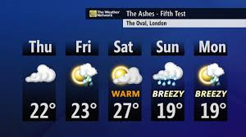




Architecture and Demo :
Farmers data
Crop Calendar
Notification
Useful information May be used

Slide 6
Question ?
Thank You

